Slide 1


Slide 2








Thanks to our sponsors

Slide 3
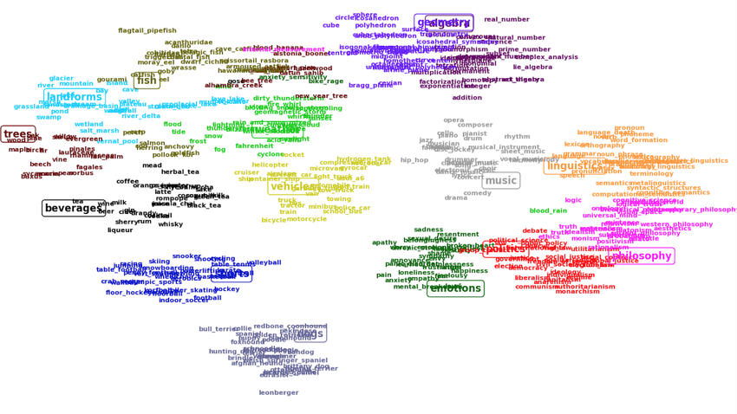

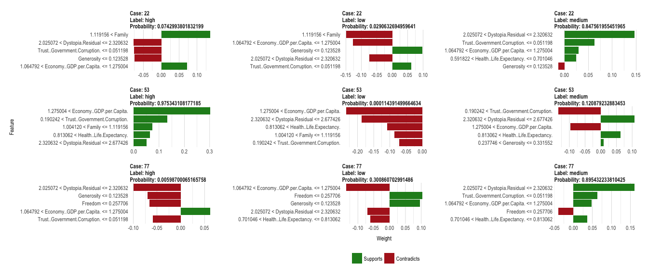
DMBI Data Hackathon – tutorial sessions
12:00 - an Introductory Tutorial on Embeddings with TensorFlow - by Taboola
16:00 - Advanced Keras Applications - by Yam Peleg
19:00 - Interpretability of Machine Learning Models - by Michaël Mariën from KBC

Slide 4
DMBI Data Hackathon - timeline
Day 1, 3/5:
9:00 - Arrival and light breakfast
9:45 - Hackathon starts! Challenges overview
12:00 - Tutorial - "an Introductory Tutorial on Embeddings with TensorFlow" by Taboola
14:00 - Lunch
16:00 - Tutorial - "Advanced Keras Applications" by Yam Peleg
19:00 - Tutorial - "Interpretability of Machine Learning Models" by Michaël Mariën from KBC
20:30 - Dinner
21:30 - Stretches and Body Relaxation
Day 2, 4/5:
00:00 - Night snacks
6:30 - Test sets are given
7:00 - Breakfast
9:00 - First judging round
11:30 - Presentation and second judging round
12:30 – winners announced
13:00 - Hackathon ends!
Things to remember:
Prepare a presentation that describes your work for judging rounds
Solutions are scored:
60% metric optimization
30% creativity and innovation
10% special insights to the data (even if not effecting selected metric)

Slide 5
challenges

Slide 6
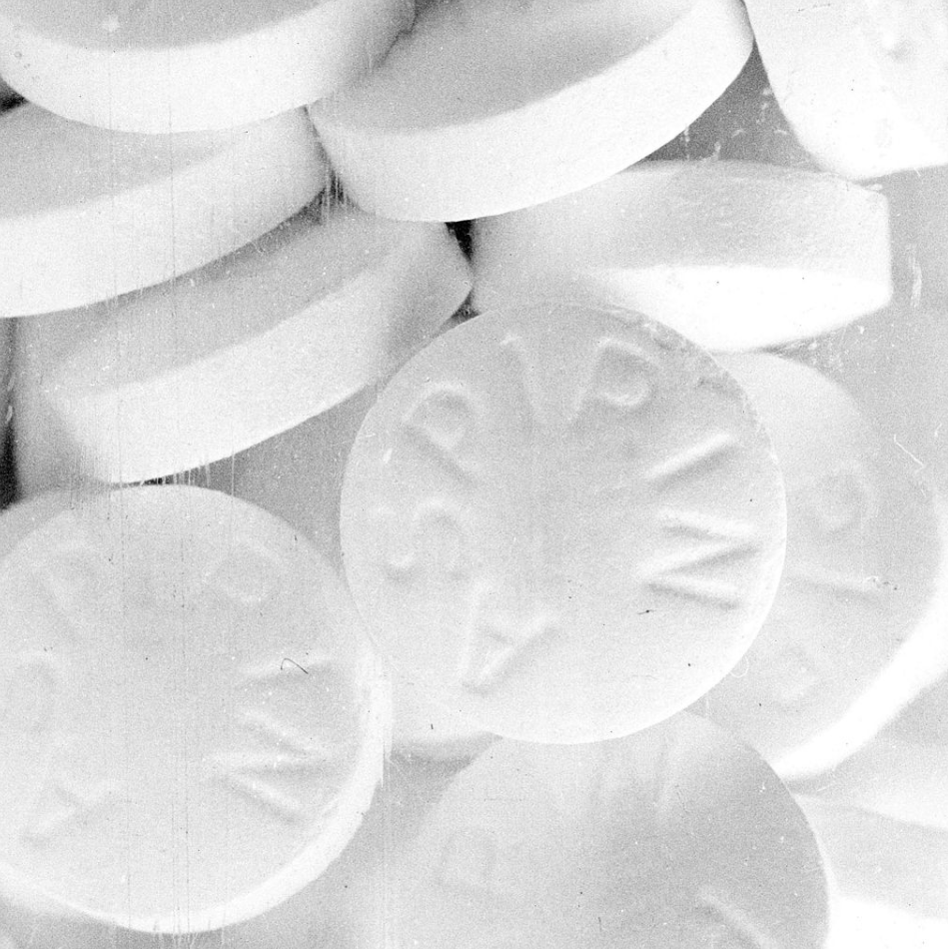
Drug-Drug interaction discovery (DDI)
Predict unknown interactions in undirected graph G = (V, E)
Test on a newer version of the database
Evaluation metric: AUC Average Precision @ k
More details in the competition page. Read it carefully
Node1_node2
0_1
1_3
0_2
2_5
6_19
Node1_node2
0_2
1_4
6_10
7_19
3_9
Input CSV structure example
Partial output CSV structure. Ordered
Guy Shtar

Slide 7


IoT device type identification
What type?
IoT IP stream
Authorized?
Input: A 297-feature vector describing a session
Output: The type of the IoT device generating this session
Evaluation metric: Classification accuracy & innovation
Note:
The training set is highly imbalanced
The training/validation/test sets don’t necessarily include the same IoT device types (unknown or omitted types in the validation/test sets)
?

Slide 8

Meteorology challenge
Predict Max daily temperature Given max temp, min temp, wind and humidity from numerical and statistical meteorological models
Data: 2 years training, 15 stations, evening and morning models per day per station
Evaluation: RMSE
Input
Output
Basis date | City | Time | Persist. value | EC | CO | C3 | OH | Obs. value
01-01-18 | Afula | 1 | 18 | 11 | 11 | 12 | 12 | 12
01-01-18 | Ashdod | 1 | 18 | 14 | 14 | 15 | 11 | 15
01-01-18 | Beer Sheva | 2 | 17 | 11 | 9 | 11 | 10 | 10
01-01-18 | Bet Shean | 1 | 19 | 12 | 13 | 16 | 12 | 15
01-01-18 | Elat | 2 | 22 | 14 | 16 | 17 | 14 | 19
Date_city | Prediction
01-01-18_Afula | 12
01-01-18_Ashdod | 14
01-01-18_Beer Sheva | 11
01-01-18_Bet Shean | 16
01-01-18_Eilat | 20

Slide 9
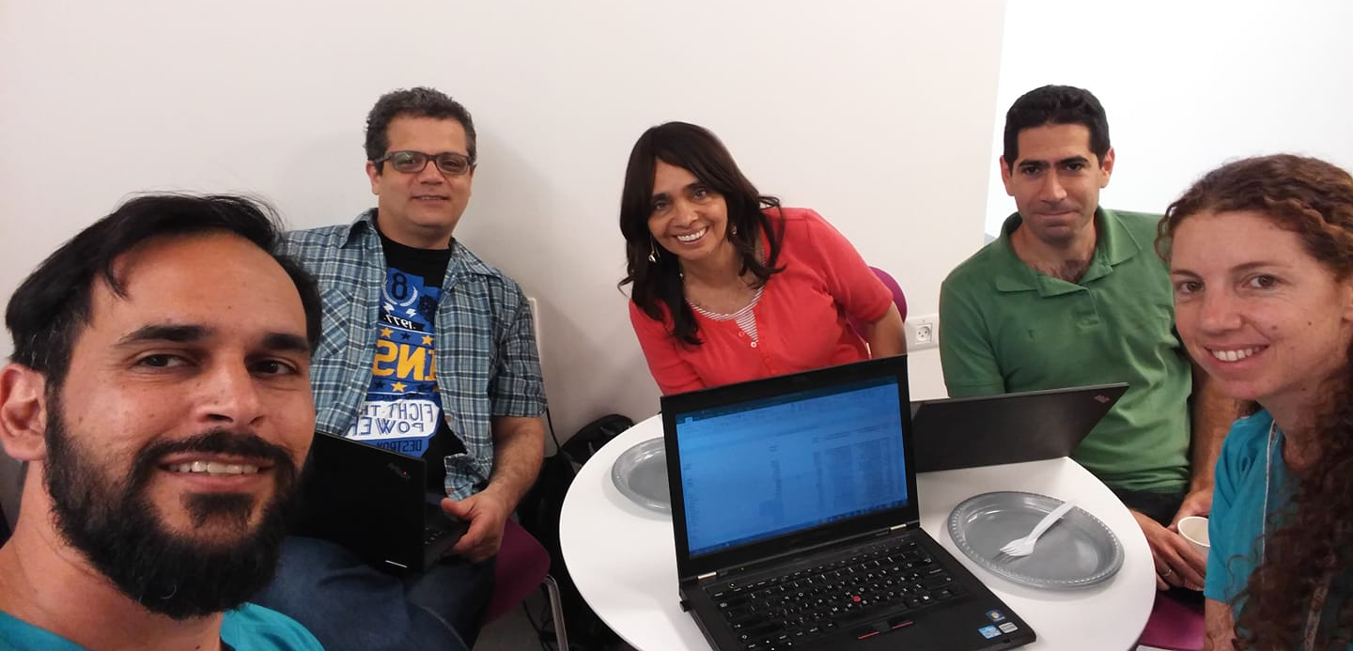

Slide 10



DMBI Data Hackathon
Challenges' leaders:
Weather prediction – Liat Friedman Antwarg 050-6348572
Drug-Drug interaction discovery – Guy Shtar 052-6703086
IoT device type identification – Yair Meidan 052-6040619
Main communication channel – Facebook group updates: https://www.facebook.com/groups/422756224817612

Slide 11
Winning teams

